Slide 2
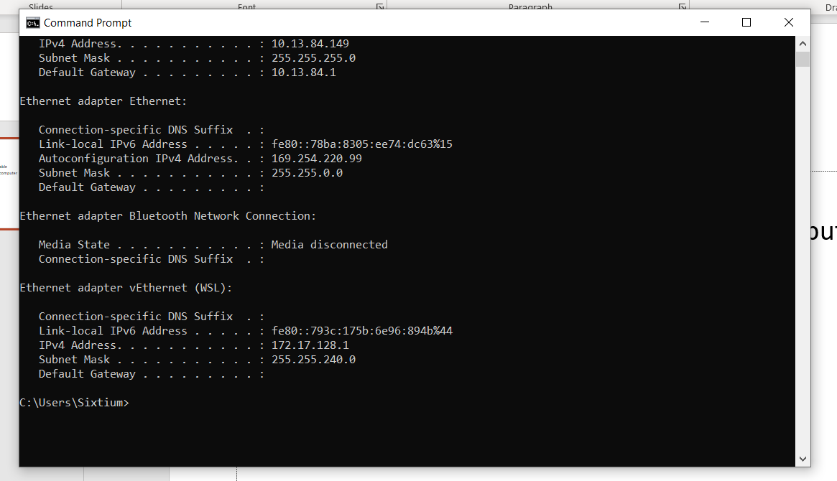
Heat3 Connection
Connect Heat3 to computer via Ethernet cable
Open up command prompt on connected computer
Type in ipconfig
Take note of Ethernet adapter Ethernet heading
Copy down Autoconfiguration IPv4 Address and Subnet Mask
Enter the IP Address and Mask into the Heat3 under Device Settings -> Communication
Open up prevac Heat3.exe program
Make sure the IP is the same IP as before
Connect

